Slide 1
Responding To, and Understanding Filicide. Challenges and Psychosocial Perspectives
Dr Julia Stroud
University of Brighton

Slide 2
Responding To, and Understanding Filicide. Challenges and Psychosocial Perspectives
Dr Julia Stroud
University of Brighton

Slide 3
Addressing Filicide
Inaugural Conference for Cross National
Dialogue
2013

Slide 4
Some initial thoughts ...
But . . .
It is the inaugural conference
And . . . It is 2013
Filicide continues to challenge us
Messages for researchers and practitioners about
how we respond to, and understand filicide . . .

Slide 5
Filicide – Two overriding dynamics
Powerlessness of children
Complexity of the phenomenon
Complex, multi-faceted, intricate, heterogeneous
(Bourget and Bradford 1990; Bourget and Labelle 1992)

Slide 6
Filicide – The powerlessness of children across cultures and time
Patria potestas power of a father in Roman Law over his children amounting even to a right to inflict capital punishment
Child sacrifice (Abraham and Isaac – sacrifice stopped; foundation
stones)
Filicide through Abandonment/ Exposure - Foundling
hospitals/ orphanages Poverty
Sex selective filicide – killing of daughters- ‘a father and
mother when they produce a boy congratulate one another,
but when they produce a girl they put it to death’ - Han Fei Tzu -
3rd Century BC Gender issues - victim and perpetrator
Euripides - Medea (killed 2 sons to avenge Jason’s betrayal)

Slide 7
21st Century - Powerlessness of children despite . . .
Protection of children – criminal legislation – child protection procedures and protocols
United Nations Convention on Rights of the Child (legally binding agreement)
Article 6 (Survival and development)
Every child has the right to life. Governments must do all they can to ensure that children survive and develop to their full potential.
Article 18 (Responsibilities; state assistance)
Both parents share responsibility for bringing up their child and should always consider what is best for the child. Governments must support parents by giving them the help they need, especially if the child’s parents work.
Article 19 (Protection from all forms of violence)
Governments must do all they can to ensure that children are protected from all forms of violence, abuse, neglect and bad treatment by their parents or anyone else who looks after them.

Slide 8
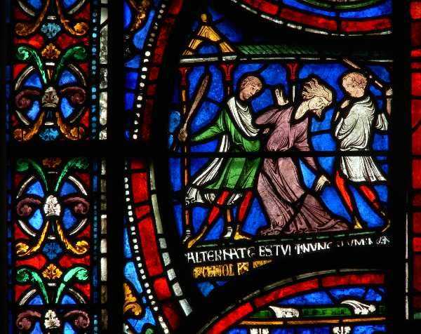
Matilda of Cologne

Slide 9
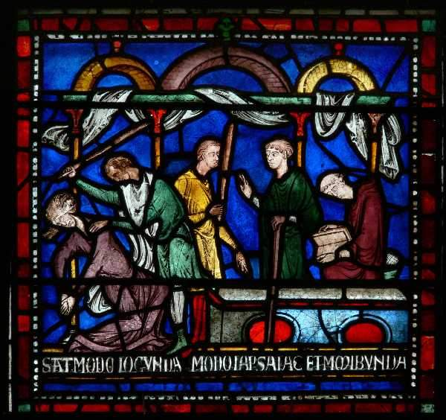
Matilda of Cologne

Slide 10
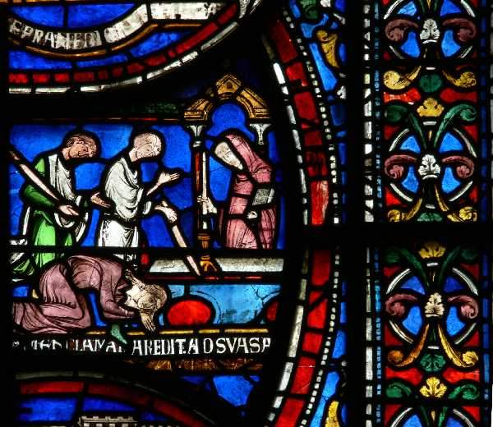
Matilda of Cologne

Slide 11
A psychological depth and reality transcending time
We saw a little woman, by the name of Matilda, who was brought from Cologne … She had torn into threads her linen smock . . . and she struck out violently at anyone who wanted to bring her forward. She would even have strangled a young boy, who ran up to her, had he not been quickly snatched out of her way. . . Bound hand and foot, she raved for some four or five hours before the tomb of the Martyr . . . Gradually Matilda regained her normal self and the next day she had completely recovered. When we asked her how she came to be insane, she said that her brother had killed a young man, who loved her dearly, and that in a fit of madness she had struck with her fist her baby son . . and removed him from this world.
Benedict of Peterborough - 12th Century

Slide 12
Art must imitate life . . .
Most forms of violence and crimes are depicted in the arts (visual arts, literature, drama, performing arts)
Physical assaults, murder, rape, sexual abuse, theft all depicted
Filicide is very rarely examined in the arts
Reflection of society’s psychological and emotional difficulties in dealing with and examining the phenomenon.
A few notable exceptions -
In art - Abraham and Isaac - Medea -

Slide 13
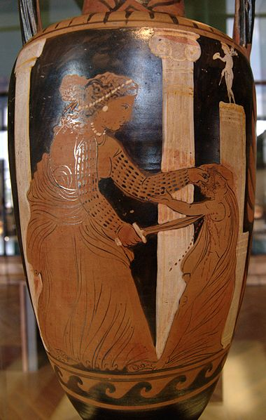
Medea – c. 330BC, The Louvre

Slide 14
In literature
‘The thought came into my mind that I might get rid of it and go home again ... The thought came all of a sudden and got stronger and stronger ... I felt that I must do it ... I didn't know how ... I thought I would find a pool ... I thought I should get rid of all my misery ... And I saw a wood a little way off ... I thought there’d perhaps be a ditch or a pond there ... I thought I could hide the child there ... I didn’t know how I felt about the baby. I seemed to hate it – it was like a heavy weight hanging round my neck ... And I’d done it in a moment’.
George Eliot 1859 Adam Bede

Slide 15
Responding to filicide
Childhood – time of vulnerability – need for nurture and protection from parents/ caregivers to ensure safety and sound development
Filicide contravenes societies’ mores about nature of parenting
‘the most emotive of all offences’
Danson and Soothill 1996: 495
‘this most unnatural crime’
Erasmus Darwin 1767, King-Hele, Ed 1981: 42

Slide 16
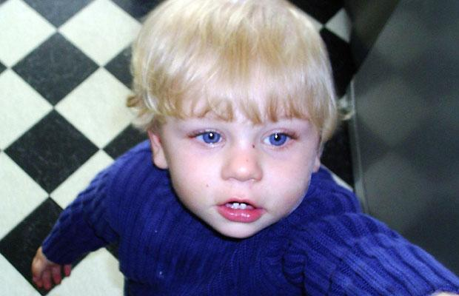
Responding to filicide
In UK, post death of Baby P -
‘The whole nation has been shocked and moved by the tragic and horrific death of Baby P. All of us find it impossible to comprehend how adults could commit such terrible acts of evil against this little boy. And the public is angry that nobody stepped in to prevent this tragedy from happening’
(Rt. Hon. Ed Balls, then Secretary of State for Children, Schools and Families: The Guardian, 1st December 2008).

Slide 17
Responding to filicide
Society responds to filicide with -
‘horror and disgust’ (Grunfeldt and Steen 1984)
‘horror, fascination and anxiety’ (Wilczynski 1997)
Filicide – ‘taboo’ (ibid)
Challenges our conceptions re. parenting and humanity

Slide 18
Challenges of Responding to Filicide
Easier to identify with victim rather than perpetrator
Violence undermines usual precautions against harm. Emphasises the ruthlessness, recklessness of perpetrators (Floud and Young 1981)
Perpetrators can be viewed with a sense of ‘otherness’
Displacement of blame on to professionals involved and away from the perpetrator and their actions and circumstances
This can impede engaging with perpetrators’ circumstances, histories, to inform understandings about the perpetrator and the commission of an offence
Potential negative effects on understanding filicide, on the development of preventative strategies

Slide 19
Complexities of filicide: challenges of terminology and definition
Are we considering the same, or different ,phenomena?
Filicide – killing of a child by a parent of ether sex
including step parents, (Resnick 1969; Wilczynski 1997;
Strang 1996)
Infanticide - UK, child < under 12 months mother only
Neonaticide - within 24 hours of birth (Resnick 1969)
Child Homicide
Fatal Child Abuse
Child murder
Manslaughter
Child death

Slide 20
Complexities of filicide: challenges of terminology and definition
Because of the complexity and the heterogeneity of the phenomenon do we need different terminology and definitions?
OR
Does it mean we are discussing different entities/ phenomena and does it preclude advancing our understanding of the issues?

Slide 21
Complexities of filicide: challenges of terminology and definition
Categorisation/ classification by motive
Resnick 1969 | Altruistic; acutely psychotic; unwanted child; accidental; spouse revenge
d’Orban 1979 | Battering mothers; mentally ill mothers; neonaticides; retaliating women; unwanted children; mercy killing
Bourget and Bradford 1990 | Pathological filicide (altruistic/ extended suicide); accidental (battering) filicide; retaliating filicide; neonaticide; paternal filicide
Wilczynski 1997 | Retaliating; jealousy of/ rejection by victim; altruistic; unwanted child/neonaticide; discipline; psychosis in parent; MSBP; killings secondary to sexual/ ritual abuse; no intent to kill/ injure; unknown motive

Slide 22
Complexities of filicide: challenges of terminology and definition
Differential classification/ categorisations
Developed from psychiatric literature – focus often mental illness
Focus also on motive
Aim to develop explanatory theories
Can be difficult to assign a case to one specific group
Retrospective analysis of motive can ignore wider situational issues
Assumption that motive assigned is correct (Brown and Tyson 2012)
but this is not always the case (Mouzos and Rushworth 2003)
Have classifications helped or impeded our interrogation of filicide?

Slide 23
Complexities of filicide: challenges of incidence
Do we know, on our country, how many children are killed by their parent(s) each year?
A rare phenomenon (Stanton et al 2000; Pritchard 2002)
Child death statistics – UK: range of data sets - different recording criteria
e.g. WHO Mortality Data and Statistics; Office for National Statistics Focus on Violent Crime and Sexual Offences; ONS Causes of Death Statistics; Child Death Overview Panel Returns; Serious Case Reviews
Different data sets show slightly different numbers of children dying as a result of violence

Slide 24
Do we know how many children are killed by their parent(s) each year?
Filicides, England and Wales
2010/11 | 56 victims under 16 (9% of all 636 homicides) 64% (n36) Killed by parent/ step parent – 77% (n43) knew killer 11% (n6) killed by stranger
2011/12 | 47 victims (9% of all 540 homicides) 60% (n28) killed by parent/ step parent – 62% (n29)knew killer 15% (n7) killed by stranger 23% victims (n11) for whom no suspect
Office for National Statistics Focus on; Violent Crime and Sexual Offences, 2011/12 – England and Wales - Feb. 2013 http://www.ons.gov.uk/ons/rel/crime-stats/crime-statistics/focus-on-violent-crime/stb-focus-on--violent-crime-and-sexual-offences-2011-12.html
England and Wales
–
––

Slide 25
Complexities of filicide: challenges of incidence
Compare child road deaths; deaths from cancer; chronic health diseases
England and Wales 2008 - total of 6,214 children aged 0-15 years died (ONS, 2010).
Cancer accounted for 20 per cent of the deaths of children aged 1-15 years (ONS, 2010).
2008 a total of 2,807 children died or were seriously injured on the roads, with 124 children dying (Department of Transport, 2009).

Slide 26
Complexities of filicide: challenges of incidence
Filicides that are not recorded as such
Wilczynski (1994) – ‘the dark number’
Deaths where cause is uncertain
Assault/ neglect may not be immediate cause of death
Legal/ evidential difficulties means conviction not achieved

Slide 27
Challenges for research
Rare - small populations – difficult to identify trends
Access to Data
Nature of:Child care data may not have full information on perpetrator’s difficulties Perpetrators data may not have full information on issues re child.
Data for criminal proceedings
Ethical issues
Perpetrator denial of offence; trauma; continued unremitting mental health issues; family issues
Voice of perpetrator rarely heard
Use of selected case samples

Slide 28
Psychosocial
Can psychosocial perspectives help in the interrogation of filicide and with the associated complexities ?
‘The interplay between the individual’s psychological condition and the social environment’ (Howe, D 2002: 170)
The importance of internal and external factors for the individual’s psychological functioning and parenting abilities
Distal and proximal factors
Psychological/ ?? Mental health perspectives

Slide 29
Psychosocial
In psychiatric and criminological studies, unexplored
reports of:
‘Psychosocial stress’ (Bourget & Bradford 1990)
‘Social stress’ (d’Orban 1979)
‘Socio-economic adversity’ (Falkov 1996)

Slide 30
A psychosocial analysis of mental disorder and child homicide Stroud J 2008
Qualitative analysis of data from forensic psychiatric reports for court: 68 individuals
42 f (62%) |  | 26 m (38%)
46 (68%) medium security |  | 22 (32%) high security
70 offences (charge of child homicide or an attempt)
56 convictions of homicide
88 victims 69 children died |  | 19 survived attempts
Most individuals were parents/ carers (n50) - 6 strangers
Ethnicity: 46 (68%)white | 22 (32%) minority ethnic groups

Slide 31
Childhood Difficulties
‘A disrupted upbringing’ (57: 84%): Multiple disadvantages – Categories not mutually exclusive
Separation/loss of parent | 35: 51%
Parental discord/ violence | 25: 37%
Physical/ sexual/ emotional abuse | 23: 34%
Neglect | 10:15%
Educational attainment: Left school at 16 yrs: Educated beyond 16 yrs: | 54:79%: 14:21%
Changes of environment | 28: 41%

Slide 32
Psychological difficulties
Delusional beliefs | 30:44%
Hopelessness and depression | 8:12%
Loss of control | 8:12%
Extreme violence as a response | 4:6%
Meeting own psychological needs | 8:12%
Unable to cope | 4:6%
Unable to accept the child | 4:6%
Atypical cases | 2:3%
N.B. Prior contact with mh services | 36:53%

Slide 33
Moving beyond individual psychopathology
Emotional impact of psychological problems (particularly delusions)
Lack of knowledge about psychological difficulties by partners/families and impact of this on the individual (e.g. children left in care of acutely mentally ill parents)
Communication problems with partners/ families mean individual’s needs are not ‘heard’ – interaction with psychological/ mh difficulties

Slide 34
Relationship difficulties and isolation
Problems in relationships with spouse/ partner/ family at offence: | 41: 60.28%
Living alone and isolated: | 22: 32.35%
Positive relationships with spouse/partner/ family at offence | 5: 7.35%

Slide 35
Unsuccessful help seeking: Potential Warnings
Unsuccessful help seeking 26: 38%
Seeking help from the wrong source
Not revealing full extent of difficulties
Poor professional response
Repeated unsuccessful help seeking
Potential Warnings 35: 51%
Prior threat/actual violence to a child
Prior threat/ actual violence to an adult
Prior actual violence to an animal

Slide 36
Difficulties in relation to the child
Difficulties in relation to the child 35: 51%
Difficulties in providing care; identification with the child; unplanned pregnancies
50 cases where perpetrator was parent/parent substitute, difficulties in relation to the child in 70% of these cases
Unplanned pregnancies 25: 37% = 50% of parents

Slide 37
Stress
Stressful life contexts 62: 91%
Enduring stress – e.g. Relationship, mh, family problems
Meaningful events and experiences 54:79%
Further and additional stress: ‘change points’ – e.g. Births,
separations, bereavements, unemployment, migration
Increase in stress shortly before offence 31: 69%
‘And then something happened…’ e.g. Partner saying s/he is
leaving; seeing ex partner who had been violent; being ‘forced’
to move

Slide 38
Psychosocial perspectives and risk of filicide
Locating ‘risk’ in the ‘pathology’ of the parent alone can be misleading - ‘surface and depth’ Howe (1996), Cooper (2005)
‘Commonly risk factors interact’ (Rutter 1989:6)
Dynamic, ecological understandings and assessments (Cicchetti and Valentino 2006: Assessment Framework 2000)
Importance of (emotional and relationship) histories – experiences of being parented, relationships, cognitive processes and life stresses all affect psychological functioning and the way parents recognise, understand, and interpret needs and behaviour of children
Intervention: need for in-depth therapeutic help over time?

Slide 39
The aftermath of the offence
Enduring effects on partners, surviving siblings, families, community
Impact on professionals involved
Post traumatic stress for perpetrator
For perpetrator, loss of contact with surviving children
High incidence of suicide in the longer term?

Slide 40
Responding to filicide – challenges to our conception of humanity
‘It should, therefore, as it must raise our horror, raise our pity too’
William Hunter 1784
‘On uncertainty in the signs of murder in bastard children’.
Medical Observations and Inquiries 6: 266-290

Slide 41
References
Bourget, D. and J. Bradford. 1990. Homicidal parents. Canadian Journal of Psychiatry. 35: 233-238.
Bourget, D. and A. Labelle. 1992. Homicide, infanticide and filicide. Psychiatric Clinics of North America. 15 (3): 661-673.
Brown, T. and Tyson, D. 2012. An abominable crime: filicide in the context of parental separation and divorce, Children Australia. 37:04: 151-168
Cicchetti ,D. and Valentino, K. 2006. An ecological transactional perspective on child maltreatment: failure of the average expectable environment and its influence upon child development. In: A.E. Kazdin and J.R. Weisz (Eds), Evidence-Based Psychotherapies for Children and Adolescents. Guildford press: New York.
Cooper, A. (2005) Surface and Depth in the Victoria Climbié report. Child and Family Social Work. 10: 1-9
Danson, L. and Soothill, K. 1996. Child murder and the media: a study of the reporting of child murder in The Times 1887-1990. Journal of Forensic Psychiatry. 7 (3): 495-503.
Department of Health. 2000. Assessing Children in Need and their Families. London: The Stationery Office.
d’Orban, P. 1979. Women who kill their children. British Journal of Psychiatry. 134: 560-571.
Falkov, A. 1996. Study of Working Together ‘Part 8’Reports. Fatal Child Abuse and psychiatric Disorder: An Analysis of 100 Area Child Protection Committee Case Reviews. London: Department of Health.
Floud, J. and Young, W. 1981. Dangerousness and Criminal Justice. London: Heinemann.

Slide 42
References
Grünfeld, B. and J. Steen. 1984. Fatal barnemishandling: barnedrap i Norgei. Tidskrift for Norsk Laegeforening. 104: 289-292.
Howe, D. 1996. Surface and depth in social work practice. pp.77-98 in N.Parton (ed) Social Theory, Social Change and Social Work. London: Routledge
Howe, D. 2002. Psychosocial work. In: Social Work. Themes, Issues and Critical Debates, edited by R. Adams, L. Dominelli and M. Payne. 2nd ed. Basingstoke: Palgrave/ OUP.
King-Hele, D., ed., 1981. The Letters of Erasmus Darwin. Cambridge. Cambridge University Press.
Mouzos, J. And Rushworth, c. 2003. Family Homicide in Australia. Trends and Issues in Crime and Criminal Justice. 255:1-6. Australian Institute of Criminology, ACT
Resnick, P. 1970. Murder of the newborn: A psychiatric review of neonaticide. American Journal of Psychiatry. 126: 1414-1420.
Rutter, M. 1989. ‘Pathways from childhood to adult life’. British Journal of Psychiatry. 30: 23-51.
Stroud, J. 2008. A psychosocial analysis of child homicide. Critical Social Policy. 28(4): 482-505
Stroud, J. and Pritchard, C. 2001. Child homicide, psychiatric disorder and dangerousness: A review and an empirical approach. British Journal of Social Work. 31: 249-269.
Wilczynski, A. 1994. The incidence of child homicide: How accurate are the official statistics? Journal of Clinical Forensic Medicine 1: 61-66
Wilczynski, A. 1997. Child Homicide. London: Greenwich Medical Media.

